Slide 1

C.R.U.D.
Charles Severance
www.wa4e.com
http://www.wa4e.com/code/crud.zip

Slide 2
CRUD Pattern
When we store things in database tables we generally need
  Create - Insert a new row
  Read - Read existing row(s)
  Update - Change some values of a record
  Delete - Delete a record
So far we have done most of CRUD

Slide 3
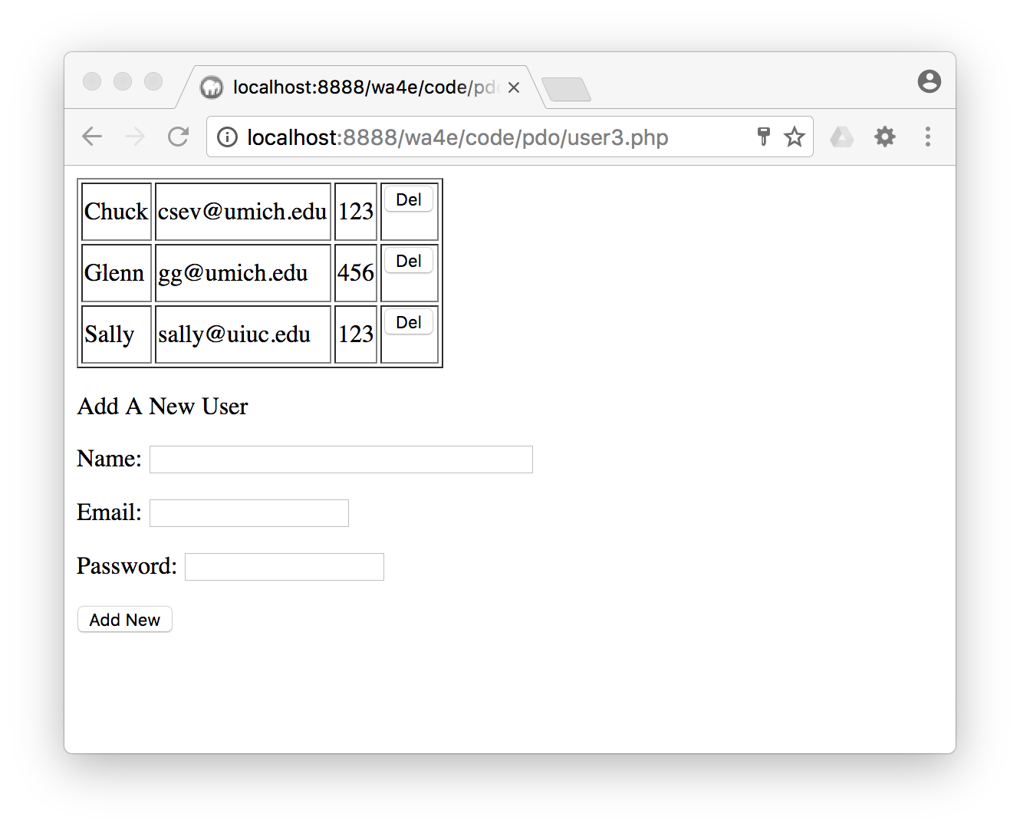
Our Program is a Little Ugly
Usually we create several screens
  Add new row
  View all rows (paging)
  View single row
  Edit single row
  Delete a row

Slide 4
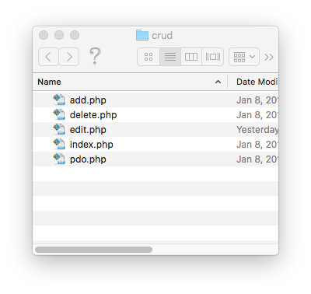
Five Separate Files
index.php - Main list and links to other files
add.php - Add a new entry
delete.php - Delete an entry
edit.php - Edit existing
view.php (if index.php needs a detail view)

Slide 5
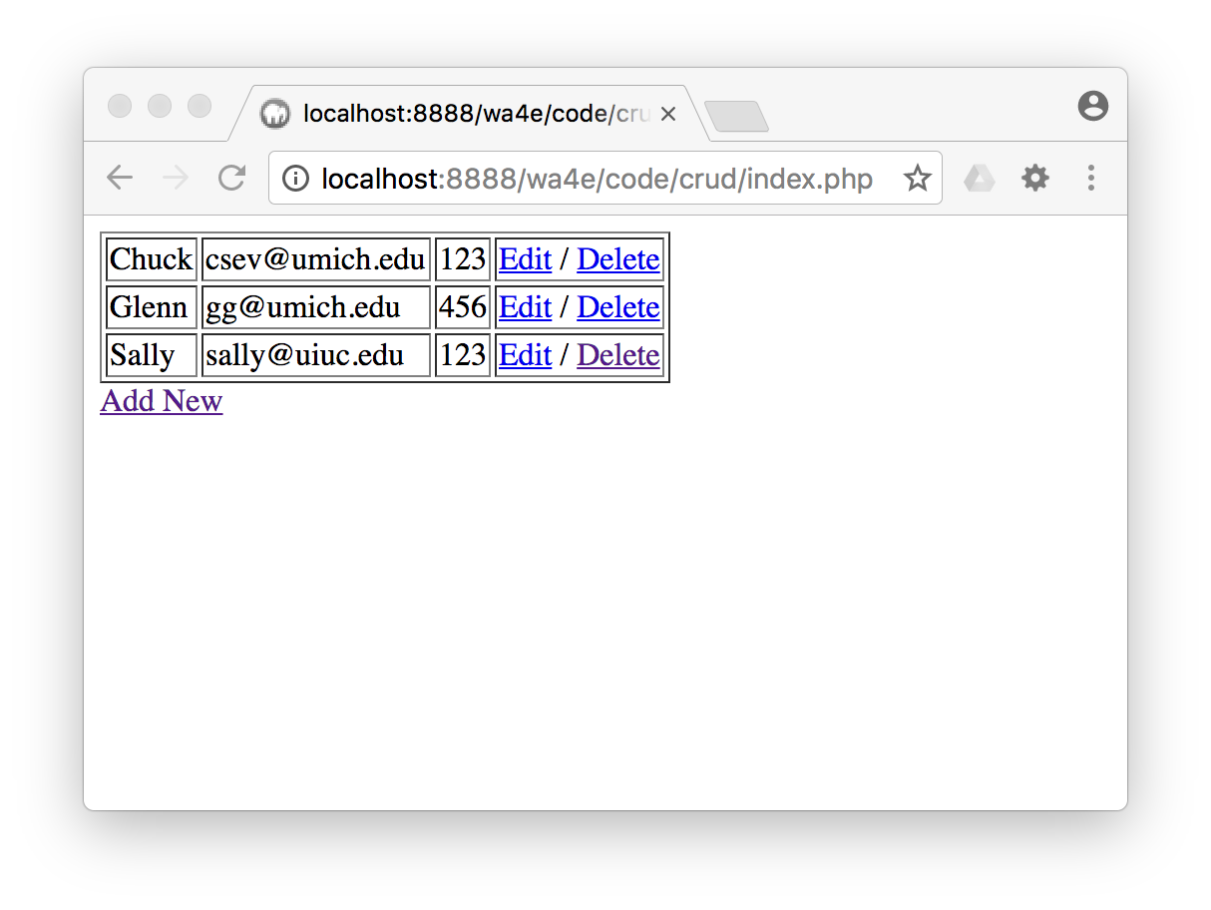
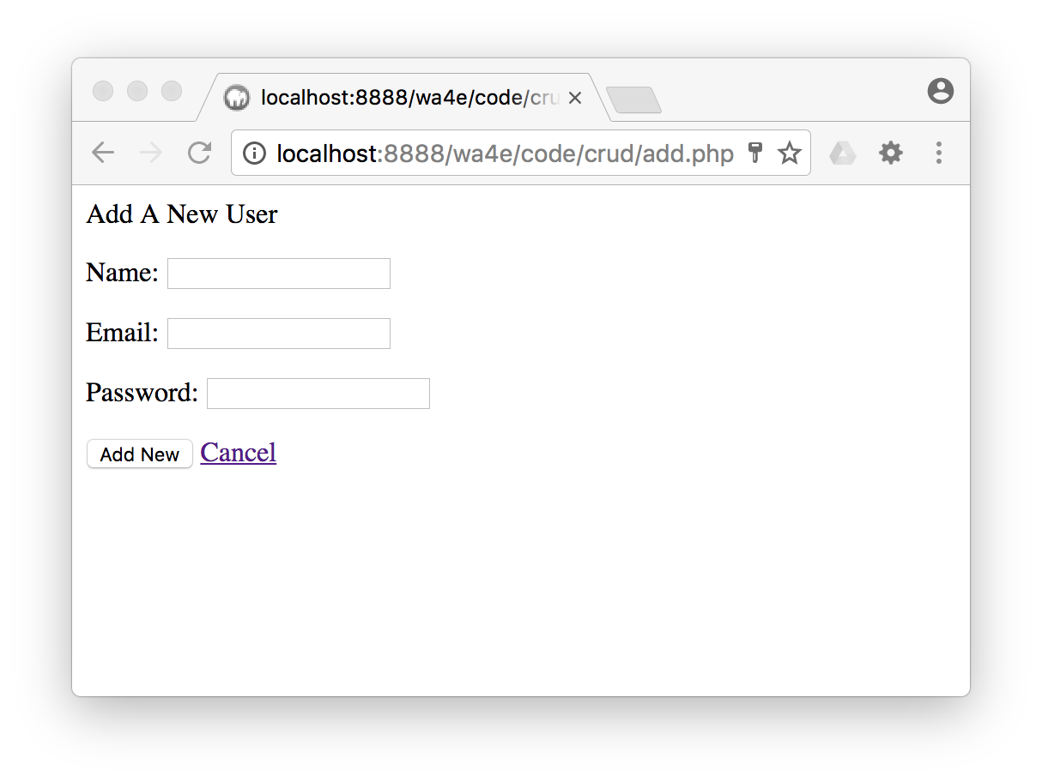

Slide 6
<?php
require_once "pdo.php";
session_start();
?>
<html><head></head>
<body>
<?php
if ( isset($_SESSION['error']) ) {
echo '<p style="color:red">'.$_SESSION['error']."</p>\n";
unset($_SESSION['error']);
}
if ( isset($_SESSION['success']) ) {
echo '<p style="color:green">'.$_SESSION['success']."</p>\n";
unset($_SESSION['success']);
}
echo('<table border="1">'."\n");
index.php

Slide 7
index.php
<?php
echo('<table border="1">'."\n");
$stmt = $pdo->query("SELECT name, email, password, user_id FROM users");
while ( $row = $stmt->fetch(PDO::FETCH_ASSOC) ) {
echo "<tr><td>";
echo(htmlentities($row['name']));
echo("</td><td>");
echo(htmlentities($row['email']));
echo("</td><td>");
echo(htmlentities($row['password']));
echo("</td><td>");
echo('<a href="edit.php?user_id='.$row['user_id'].'">Edit</a> / ');
echo('<a href="delete.php?user_id='. $row['user_id'].'">Delete</a>');
echo("\n</form>\n");
echo("</td></tr>\n");
}
?>
</table>
<a href="add.php">Add New</a>
?>

Slide 8
<tr><td>Chuck</td><td>csev@umich.edu</td><td>123</td><td>
<a href="edit.php?user_id=1">Edit</a> /
<a href="delete.php?user_id=1">Delete</a></td></tr>
<tr><td>Glenn</td><td>gg@umich.edu</td><td>456</td><td>
<a href="edit.php?user_id=2">Edit</a> /
<a href="delete.php?user_id=2">Delete</a></td></tr>

Slide 9
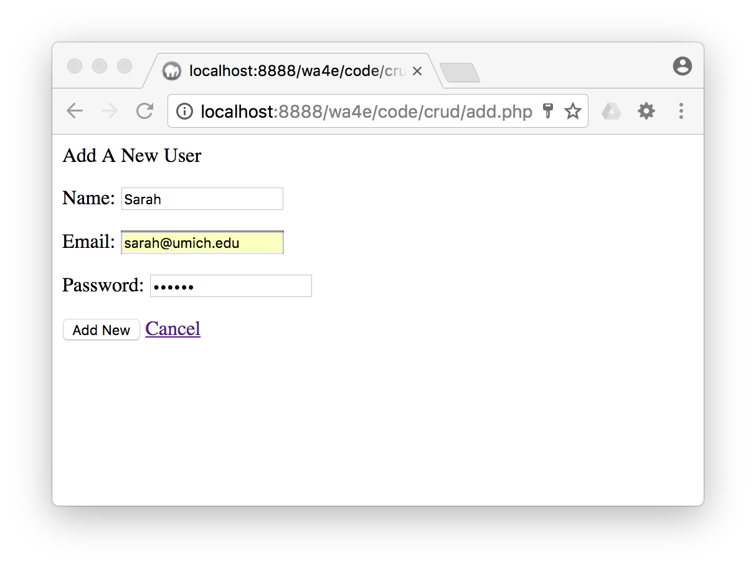
<?php
require_once "pdo.php";
session_start();
if ( isset($_POST['name']) && isset($_POST['email'])
&& isset($_POST['password'])) {
$sql = "INSERT INTO users (name, email, password)
VALUES (:name, :email, :password)";
$stmt = $pdo->prepare($sql);
$stmt->execute(array(
':name' => $_POST['name'],
':email' => $_POST['email'],
':password' => $_POST['password']));
$_SESSION['success'] = 'Record Added';
header( 'Location: index.php' ) ;
return;
}
?>
<p>Add A New User</p>
<form method="post">
<p>Name:<input type="text" name="name"></p>
<p>Email:<input type="text" name="email"></p>
<p>Password:<input type="password" name="password"></p>
<p><input type="submit" value="Add New"/>
<a href="index.php">Cancel</a></p>
</form>
add.php

Slide 10

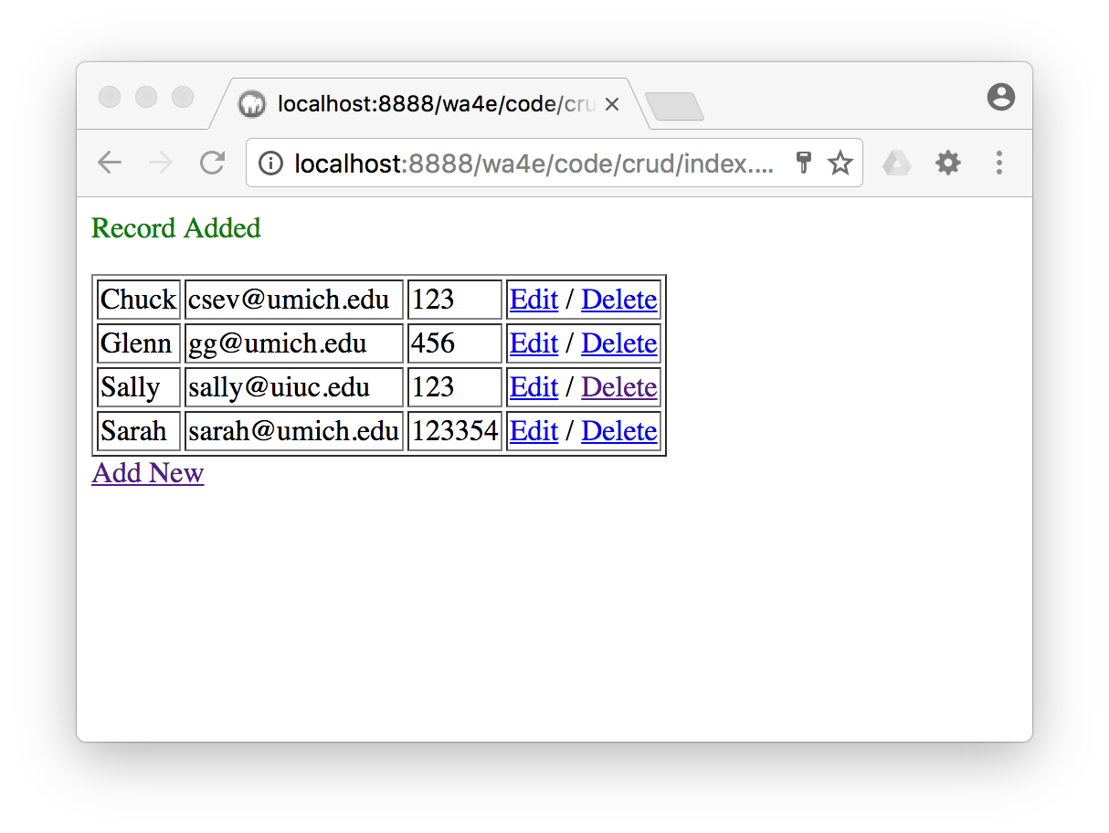
<?php
if ( isset($_POST['name']) && isset($_POST['email'])
&& isset($_POST['password'])) {
$sql = "INSERT INTO users (name, email, password)
VALUES (:name, :email, :password)";
$stmt = $pdo->prepare($sql);
$stmt->execute(array(
':name' => $_POST['name'],
':email' => $_POST['email'],
':password' => $_POST['password']));
$_SESSION['success'] = 'Record Added';
header( 'Location: index.php' ) ;
return;
if ( isset($_SESSION['success']) ) {
echo '<p style="color:green">'.$_SESSION['success']."</p>\n";
unset($_SESSION['success']);
}

Slide 11
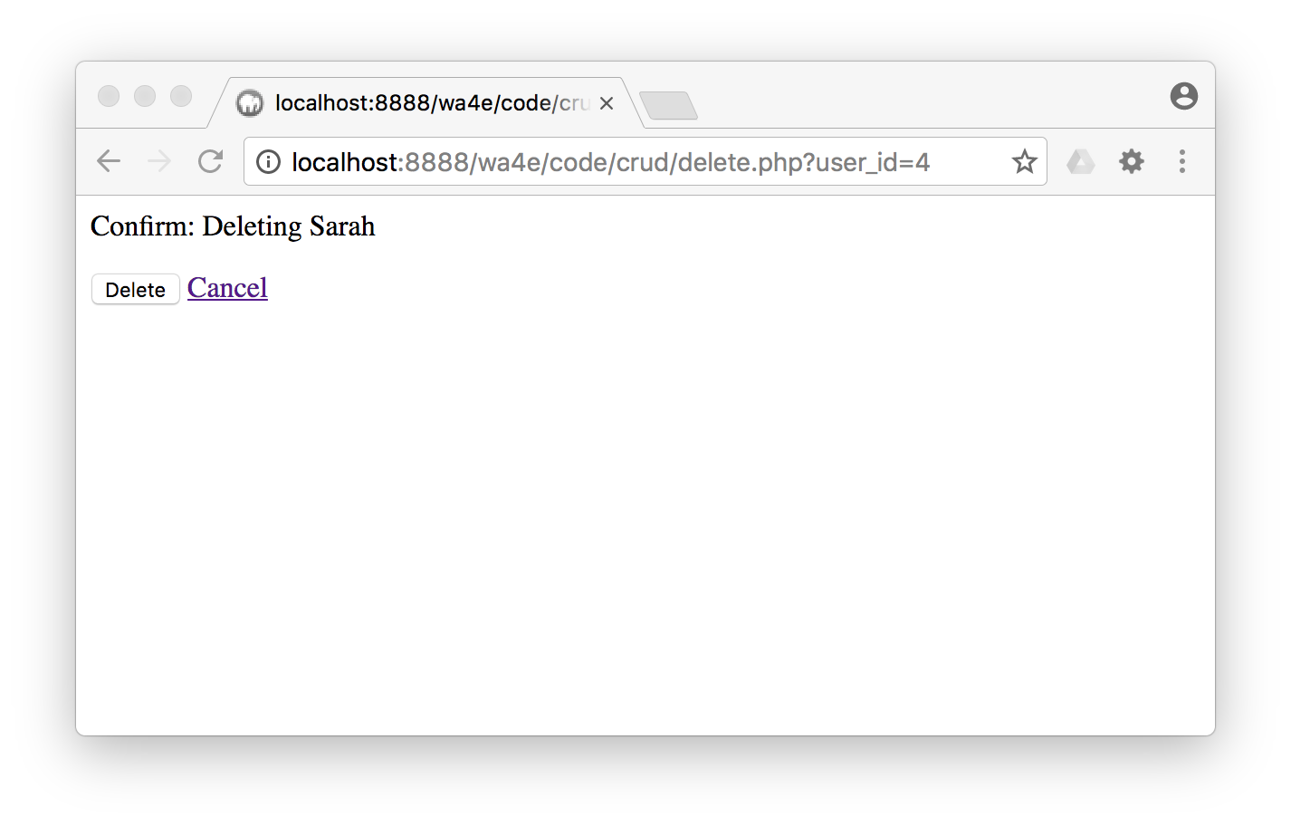
<?php
require_once "pdo.php";
session_start();
if ( isset($_POST['delete']) && isset($_POST['user_id']) ) {
$sql = "DELETE FROM users WHERE user_id = :zip";
$stmt = $pdo->prepare($sql);
$stmt->execute(array(':zip' => $_POST['user_id']));
$_SESSION['success'] = 'Record deleted';
header( 'Location: index.php' ) ;
return;
}
$stmt = $pdo->prepare("SELECT name, user_id FROM users where user_id = :xyz");
$stmt->execute(array(":xyz" => $_GET['user_id']));
$row = $stmt->fetch(PDO::FETCH_ASSOC);
if ( $row === false ) {
$_SESSION['error'] = 'Bad value for user_id';
header( 'Location: index.php' ) ;
return;
}
?>
<p>Confirm: Deleting <?= htmlentities($row['name']) ?></p>
<form method="post"><input type="hidden"
name="user_id" value="<?= $row['user_id'] ?>">
<input type="submit" value="Delete" name="delete">
<a href="index.php">Cancel</a>
</form>
delete.php
Don't alter data in a GET.

Slide 12
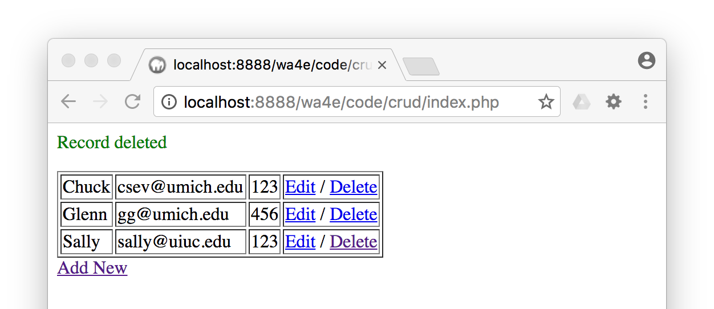
<?php
if ( isset($_POST['delete']) && isset($_POST['user_id']) ) {
$sql = "DELETE FROM users WHERE user_id = :zip";
$stmt = $pdo->prepare($sql);
$stmt->execute(array(':zip' => $_POST['user_id']));
$_SESSION['success'] = 'Record deleted';
header( 'Location: index.php' ) ;
return;
}
?>
if ( isset($_SESSION['success']) ) {
echo '<p style="color:green">'.$_SESSION['success']."</p>\n";
unset($_SESSION['success']);}

Slide 13
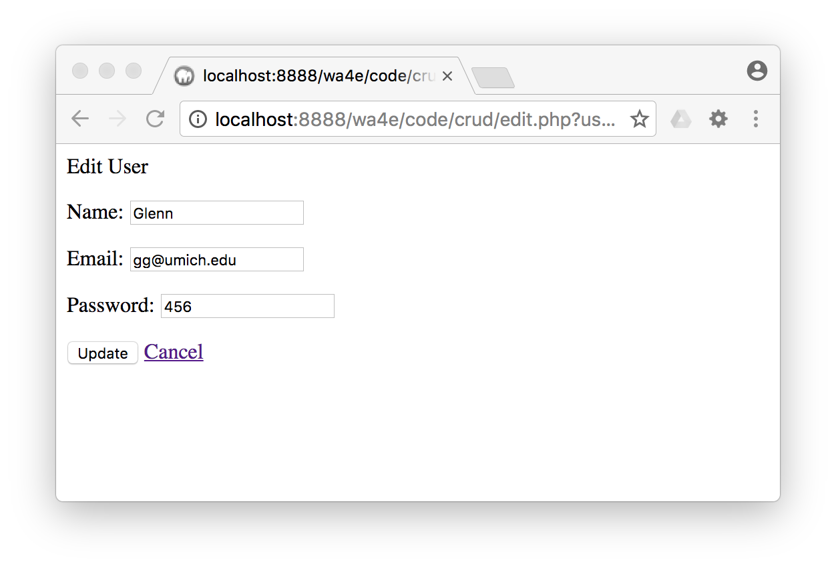
<?php
require_once "pdo.php";
session_start();
if ( isset($_POST['name']) && isset($_POST['email'])
&& isset($_POST['password']) && isset($_POST['user_id']) ) {
$sql = "UPDATE users SET name = :name,
email = :email, password = :password
WHERE user_id = :user_id";
$stmt = $pdo->prepare($sql);
$stmt->execute(array(
':name' => $_POST['name'],
':email' => $_POST['email'],
':password' => $_POST['password'],
':user_id' => $_POST['user_id']));
$_SESSION['success'] = 'Record updated';
header( 'Location: index.php' ) ;
return;
}
$stmt = $pdo->prepare("SELECT * FROM users where user_id = :xyz");
$stmt->execute(array(":xyz" => $_GET['user_id']));
$row = $stmt->fetch(PDO::FETCH_ASSOC);
if ( $row === false ) {
$_SESSION['error'] = 'Bad value for user_id';
header( 'Location: index.php' ) ;
return;
}
edit.php

Slide 14
$n = htmlentities($row['name']);
$e = htmlentities($row['email']);
$p = htmlentities($row['password']);
$user_id = $row['user_id'];
?>
<p>Edit User</p>
<form method="post">
<p>Name:
<input type="text" name="name" value="<?= $n ?>"></p>
<p>Email:
<input type="text" name="email" value="<?= $e ?>"></p>
<p>Password:
<input type="text" name="password" value="<?= $p ?>"></p>
<input type="hidden" name="user_id" value="<?= $user_id ?>">
<p><input type="submit" value="Update"/>
<a href="index.php">Cancel</a></p>
</form>
edit.php

Slide 15
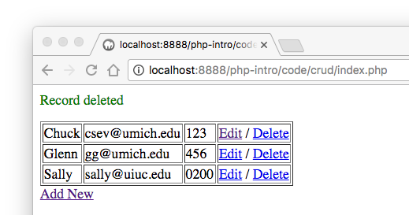
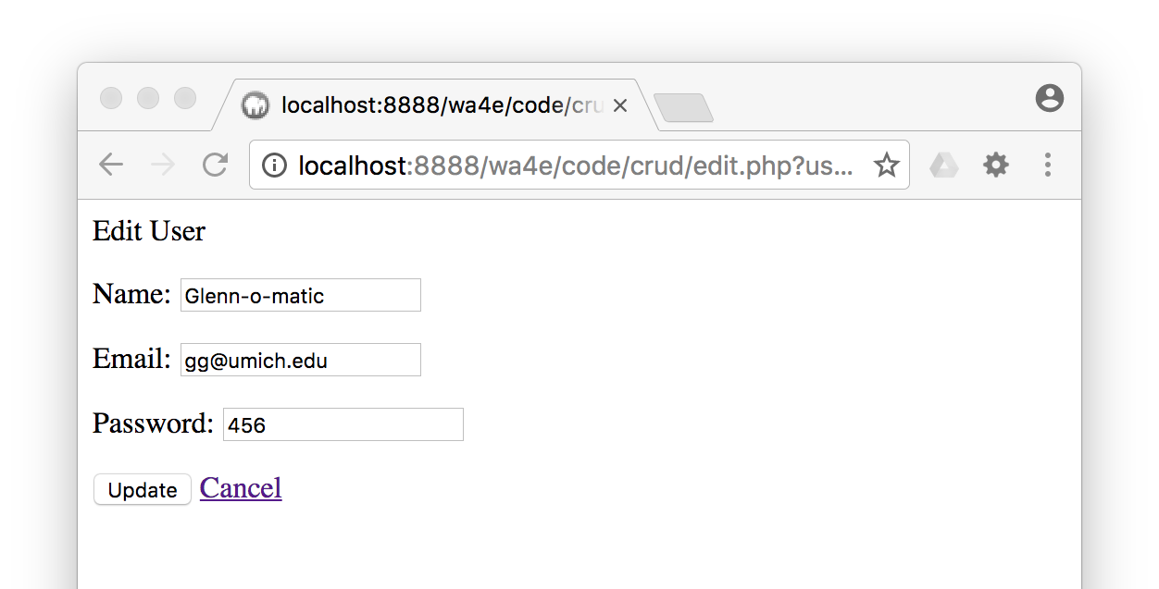
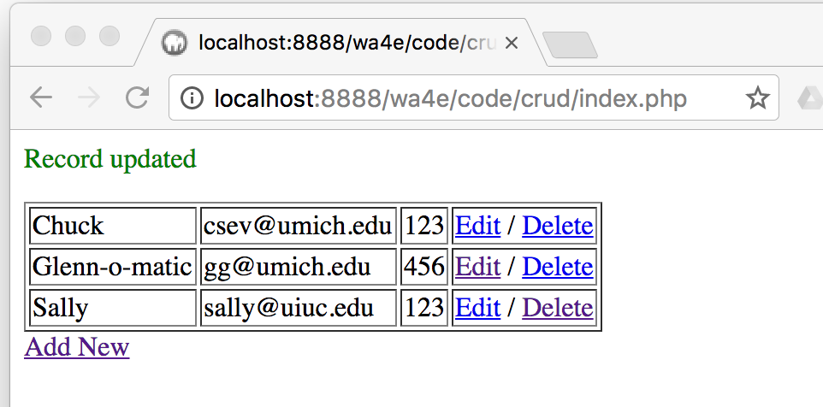
if ( isset($_POST['name']) && isset($_POST['email'])
&& isset($_POST['password']) && isset($_POST['user_id']) ) {
$sql = "UPDATE users SET name = :name,
email = :email, password = :password
WHERE user_id = :user_id";
$stmt = $pdo->prepare($sql);
$stmt->execute(array(
':name' => $_POST['name'],
':email' => $_POST['email'],
':password' => $_POST['password'],
':user_id' => $_POST['user_id']));
$_SESSION['success'] = 'Record updated';
header( 'Location: index.php' ) ;
return;
}
edit.php

Slide 16
Summary
Making database connections
Doing database operations
SQL security (a.k.a. we love PDO prepared statements)
Exploring errors...
A multi-file CRUD application with redirect

Slide 17

Acknowledgements / Contributions
These slides are Copyright 2010- Charles R. Severance (www.dr-chuck.com) as part of www.wa4e.com and made available under a Creative Commons Attribution 4.0 License. Please maintain this last slide in all copies of the document to comply with the attribution requirements of the license. If you make a change, feel free to add your name and organization to the list of contributors on this page as you republish the materials.
Initial Development: Charles Severance, University of Michigan School of Information
Insert new Contributors and Translators here including names and dates
Continue new Contributors and Translators here
Notes:
Note from Chuck. Please retain and maintain this page as you remix and republish these materials. Please add any of your own improvements or contributions.

